Slide 1
MAML Model-Agnostic Meta-Learning for Fast Adaptation for Deep Networks
Animesh Renanse
IIT Guwahati

Slide 2
Contents
Meta-Learning Problem Setup (Definition & Goal)
Prior Work
Model Agnostic Meta Learning
Characteristics
Intuition
Approach
Supervised Learning
Gradient of Gradient
Reinforcement Learning
Experiment
Discussion

Slide 3
Meta-Learning Problem Set-up
1. Problem Set-up
Definition of meta-learning:
Learner is trained by meta-learner to be able to learn on many different tasks.
Definition of “Meta” : Concerning or providing information about members of its own category .
•
Goal:
Learner quickly learn new tasks from a small amount of new data.

Slide 4
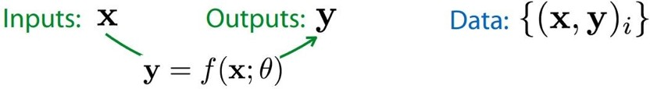
Meta Supervised Learning
1. Problem Set-up
Supervised learning:
•
Meta supervised learning?

Slide 5
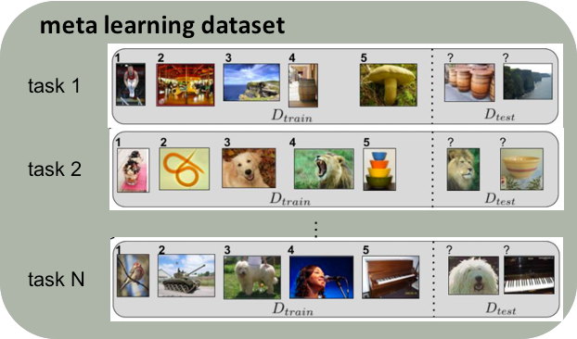
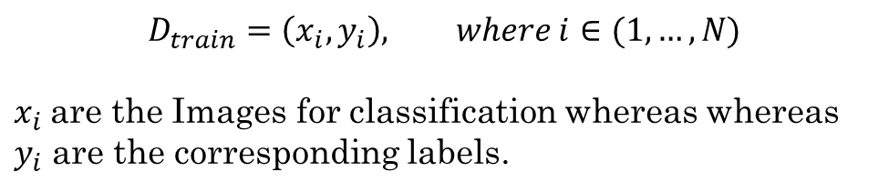
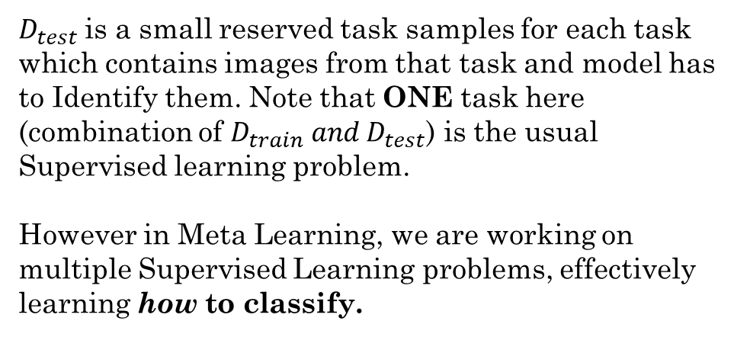
1. Problem Set-up
Meta Supervised Learning
$$D_{train}=\left(x_{i}, y_{i}\right), where i∈(1,…,N)$$
$x_{i}$are the Images for classification whereas whereas $y_{i}$ are the corresponding labels.
$D_{test}$is a small reserved task samples for each task which contains images from that task and model has to Identify them. Note that ONE task here (combination of $D_{train} and D_{test}$) is the usual Supervised learning problem.
However in Meta Learning, we are working on multiple Supervised Learning problems, effectively learning how to classify.

Slide 6
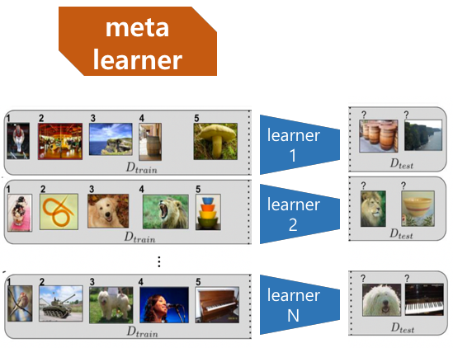
1. Problem Set-up
Meta Supervised Learning
Learns how to classify, can be another Neural Net, or just an Optimizer(MAML)

Slide 7

1. Problem Set-up
Meta Supervised Learning

Slide 8
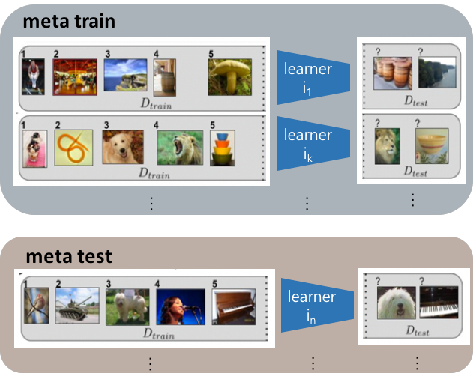
1. Problem Set-up
Meta Supervised Learning

Slide 9
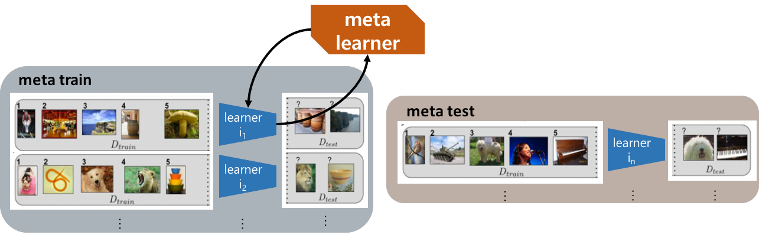
1. Problem Set-up
Meta Supervised Learning

Slide 10

1. Problem Set-up
Meta Supervised Learning

Slide 11

1. Problem Set-up
Meta Supervised Learning

Slide 12
WARNING!
Actual description of how all these constructs came to be actually originated from Probabilistic View of Supervised Learning, so please refer to that for better understanding.
[ICML Tutorial by Chelsea Finn & Sergey Levine might be a good start]

Slide 13
Prior Work
2. Prior Work
Learning an update function or update rule
Dynamic Loss Functions [Learning to Teach with Dynamic Loss Functions, Lijun Wu et. al. ]
( or, Learning to learn by gradient descent by gradient descent)
Meta LSTM optimizer
(Optimization as a model for few-shot learning)
•
•
Few shot (or meta) learning for specific tasks
Generative modeling (Neural Statistician, Edwards et al)
Image classification (Matching Net., Prototypical Net.)
Reinforcement learning
(Benchmarking deep reinforcement learning for continuous control)
•
•
•

Slide 14
Prior Work
2. Prior Work
Memory-augmented meta-learning
Memory-augmented models on many tasks
(Meta-learning with memory-augmented neural networks)
Architectures like Differential Neural Computers, NTMs among others, have been shown to work well with Meta Learning tasks.
•
Parameter initialization of deep networks
Exploring sensitivity while maintaining Internal representation (Overcoming catastrophic forgetting in NN)
Data-dependent Initializer
(Data-Dependent Initialization of CNN)
(Gradient-based hyperparameter optimization through reversible learning)
•
•

Slide 15
Model-Agnostic Meta-Learning (MAML)
3. Model-Agnostic Meta-Learning (MAML)
Goal:
Quickly adapt to new tasks on distribution with only small amount of data and
with only a few gradient steps, even one gradient step.
•
Learner:
Learn a new task by using a single gradient step.
Meta-learner:
Learn a generalized parameter initialization of model.
•
•

Slide 16
Characteristics of MAML
3. Model-Agnostic Meta-Learning (MAML)
The MAML learner’s weights are updated using the gradient, rather than a learned update.
Not need additional parameters nor require a particular learner architecture.
•
Fast adaptability through good parameter initialization
Explicitly optimizes to learn Internal representation (i.e. suitable for many tasks).
Maximizes sensitivity of new task losses to the model parameters.
•

Slide 17
Characteristics of MAML
3. Model-Agnostic Meta-Learning (MAML)
Model-agnostic (No matter whatever model is)
Classification & regression with differentiable losses, Policy gradient RL. The model should be parameterized.
No other assumptions on the form of the model.
•
•
•
Task-agnostic (No matter whatever task is)
Adopted all knowledge-transferable tasks.
No other assumption is required.

Slide 18
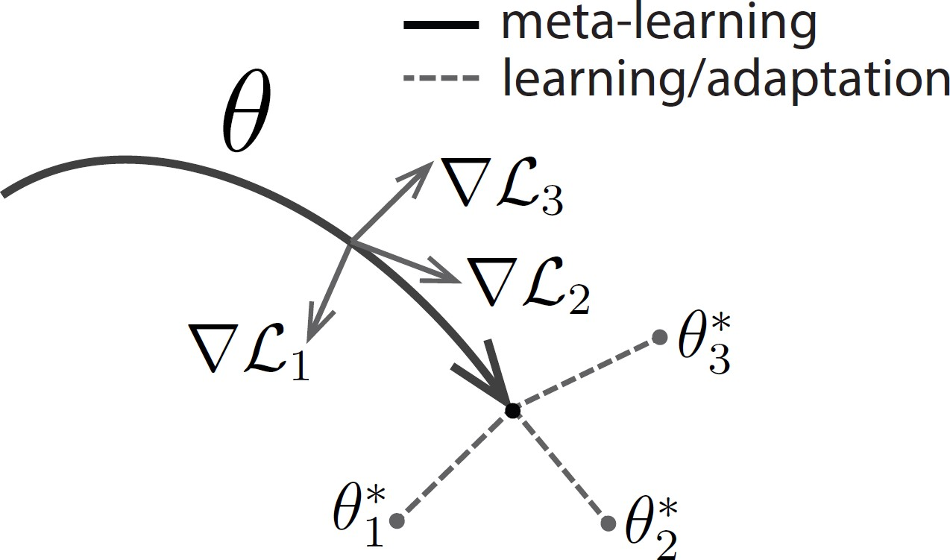
Intuition of MAML
3. Model-Agnostic Meta-Learning (MAML)
Some internal representations
are more transferrable than others.
•
Desired model parameter set is θ such that:
Applying one (or a small # of) gradient step to θ
on a new task will produce maximally effective behavior.
→ Find θ that commonly decreases loss of each task
after adaptation.

Slide 19
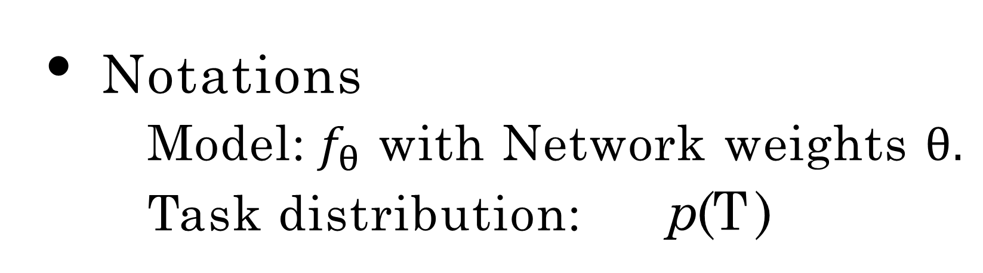
Supervised Learning
4. Approach
Notations
Model: $f_{θ}$ with Network weights $θ.$
Task distribution: p(T )
•
•
(Model-agnostic)
For each Task: T = {L(x₁, y₁, . . . , x_{K} , y_{K}), (x, y) ⇠ q}
Data distribution: q (K samples are drawn from q)
Loss function:
MSE for Regression
Cross entropy for classification
Any other differentiable loss functions can be used.

Slide 20
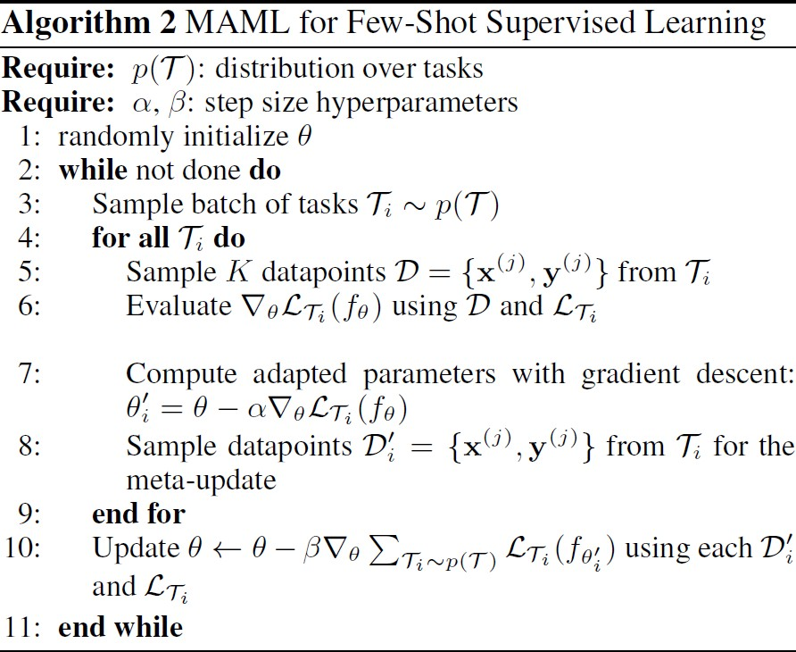
4. Approach
Supervised Learning

Slide 21
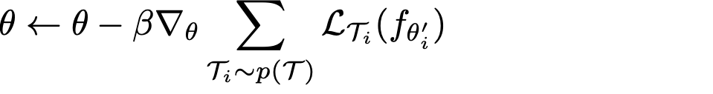

Gradient of Gradient
4. Approach
From line 10 in Algorithm 2,
(Recall:
)

Slide 22
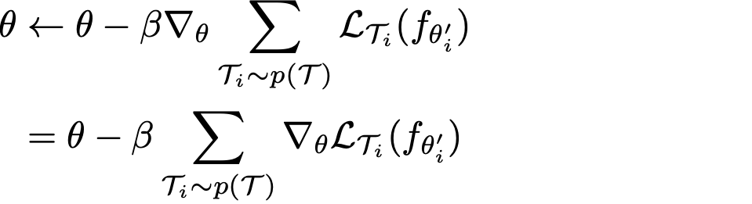
Gradient of Gradient
4. Approach
From line 10 in Algorithm 2,
(Recall:
)
(derivative of sum is sum over derivatives)

Slide 23
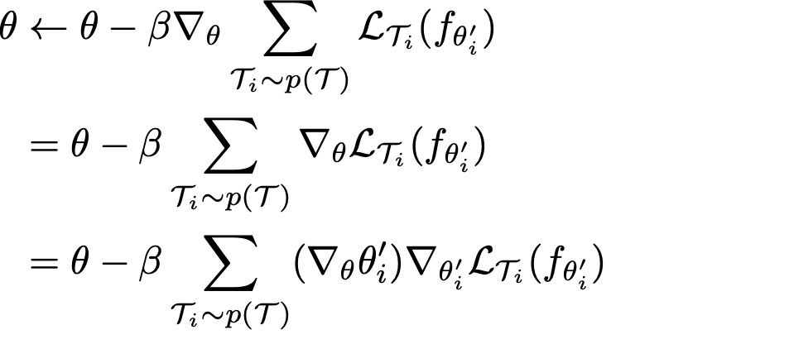
Gradient of Gradient
4. Approach
From line 10 in Algorithm 2,
(Recall:
)
(derivative of sum is sum over derivatives)
(usual Chain Rule)

Slide 24
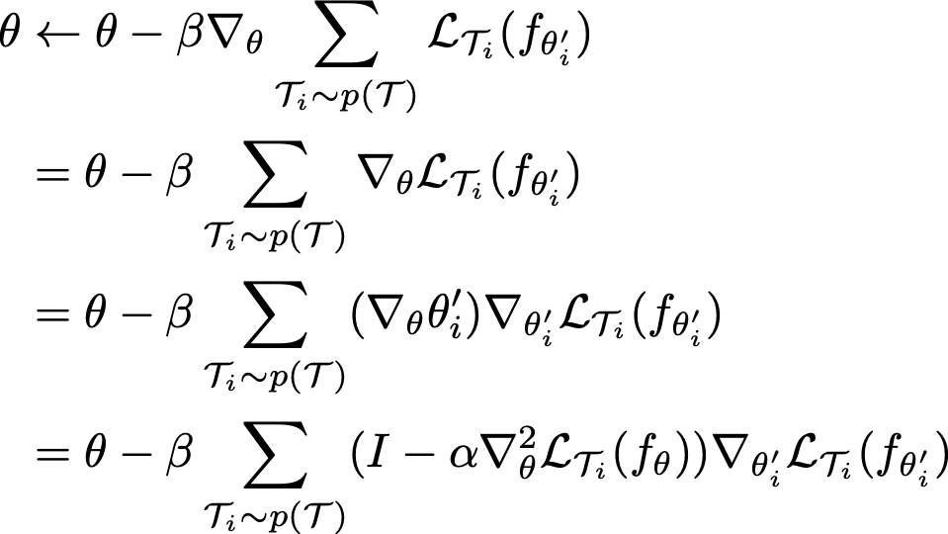
Gradient of Gradient
4. Approach
From line 10 in Algorithm 2,
(Recall:
)
(derivative of sum is sum over derivatives)
(usual Chain Rule)
( )

Slide 25
Gradient of Gradient
4. Approach
From line 10 in Algorithm 2,
(Recall:
)
(derivative of sum is sum over derivatives)
(usual Chain Rule)
( )
Calculation of Hessian matrix is required.

Slide 26
Gradient of Gradient
4. Approach
From line 10 in Algorithm 2,
(Recall:
)
(derivative of sum is sum over derivatives)
(usual Chain Rule)
( )
Instead, MAML suggests to do First Order Approximation

Slide 27
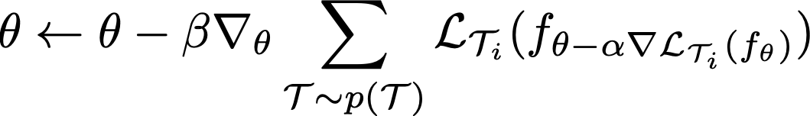
First Order Approximation
4. Approach
Update rule of MAML:

Slide 28
First Order Approximation
4. Approach
Update rule of MAML:
This part needs calculation of Hessian Matrix. Thus making MAML quite slow.

Slide 29
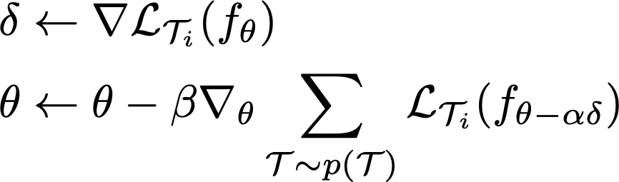
First Order Approximation
4. Approach
Update rule of MAML:
•
Update rule of MAML with 1st order approximation:

Slide 30
First Order Approximation
4. Approach
Update rule of MAML:
•
Update rule of MAML with 1st order approximation:
(Regard
as constant)

Slide 31
Gradient of Gradient
4. Approach
From line 10 in Algorithm 2,
(Recall:
)
(derivative of sum is sum over derivatives)
(usual Chain Rule)
( )
In 1st order approximation,
we regard this as identity matrix I.

Slide 32
Reinforcement Learning
4. Approach
Notations
Policy of an agent: f✓
•
•
such that a_t \sim f_\theta (x_t)
Task distribution: p(T )
For each Task:
•
T = {L(e₁, e₂, . . . , e_{K}), x₁ ⇠ q(x), x_{t+1} ⇠ q(x|x_{t}, a_{t}), H}
•
Transition distribution: q (K trajectories are drawn from q and f)
Episode length: H
Loss function: = expectation of sum of rewards
Episode: e = (x₁, a₁, . . . , x_{H} , a_{H} )

Slide 33
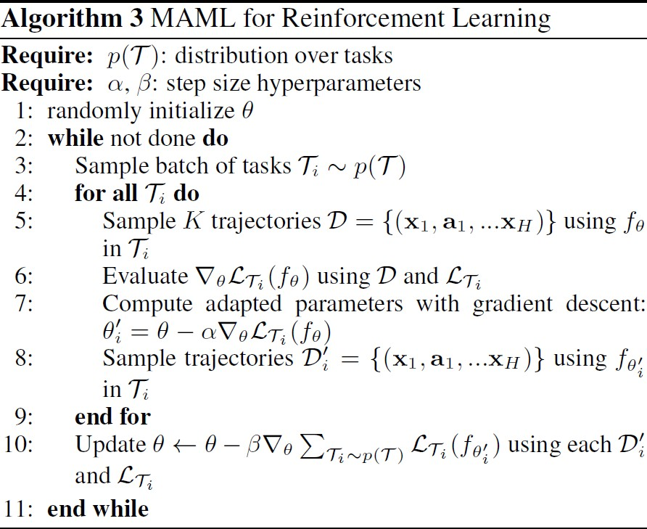
4. Approach
Reinforcement Learning

Slide 34
Experiment on Few-Shot Classification
5. Experiment
Omniglot (Lake et al., 2012)
50 different alphabets, 1623 characters.
20 instances for each characters were drawn by 20 different people. 1200 for training, 423 for test.
•
•
•
Mini-Imagenet (Ravi & Larochelle, 2017)
Classes for each set: train=64, validation=12, test=24.

Slide 35
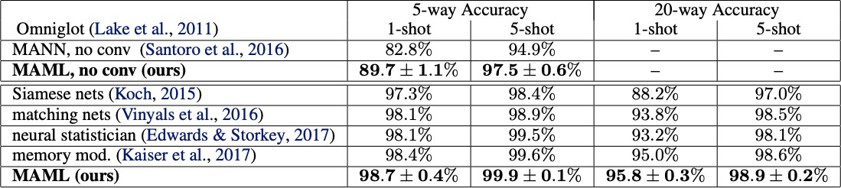
Results of Few-Shot Classification
5. Experiment
MAML outperforms state-of-arts algorithms.

Slide 36
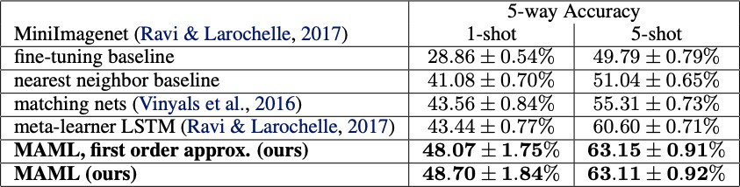
Effect of 1st Order Approximation
5. Experiment
•
•
In 1st order approximation, computation is roughly 33% better. Performances are similar.

Slide 37
Effect of 1st Order Approximation
5. Experiment
•
•
In 1st order approximation, computation is roughly 33% better. Performances are similar.
Performances are not that different.

Slide 38
Effect of 1st Order Approximation
5. Experiment
•
•
In 1st order approximation, computation is roughly 33% better. Performances are similar.
Some performance is even better.

Slide 39
Experiments on Regression
5. Experiment
Sinusoid function:
Amplitude (A) and phase (ɸ) are varied between tasks
A in [0.1, 0.5]
ɸ in [0, π]
x in [-5.0, 5.0]
•
Loss function: Mean Squared Error (MSE)
Regressor: 2 hidden layers with 40 units and ReLU
Training
Use only 1 gradient step for learner
K = 5 or 10 example (5-shot learning or 10-shot learning) Fixed step size (ɑ=0.01) for Adam optimizer.
•
•
•

Slide 40
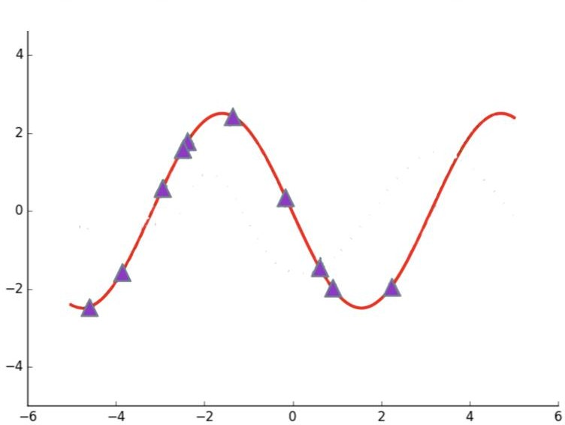
Results of 10-Shot Learning Regression
5. Experiment
[MAML] [Pretraining + Fine-tuning]
The red line is ground truth.
TARGET: Fit this sine function with only few (10) samples.

Slide 41
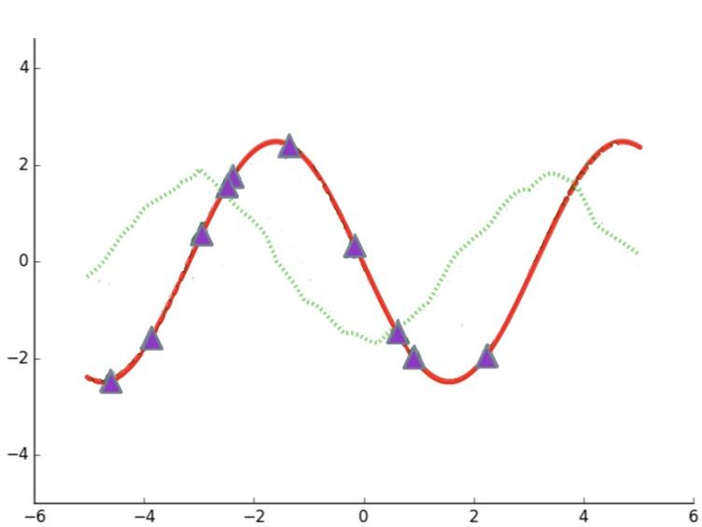
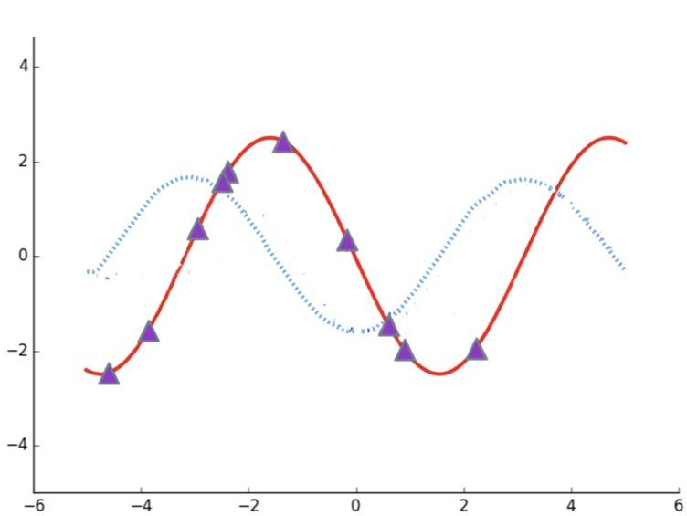
Results of 10-Shot Learning Regression
5. Experiment
[MAML] [Pretraining + Fine-tuning]
Above plots are the pre-trained function of two models. (The prediction of meta-parameter of MAML,
The prediction of co-learned parameter of vanilla multi-task learning)

Slide 42
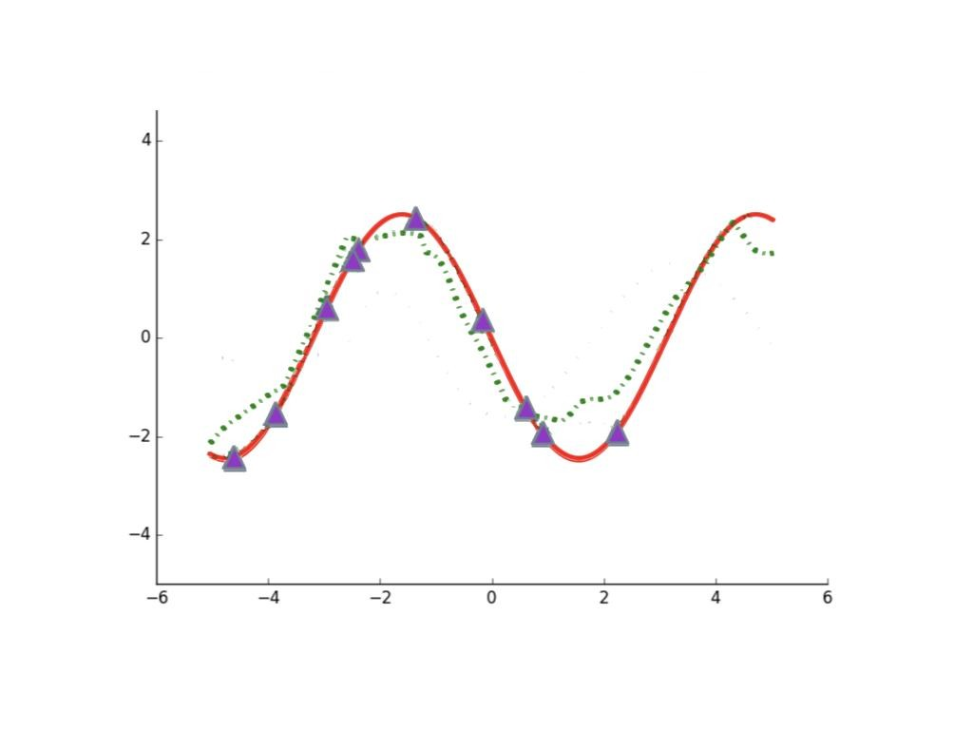
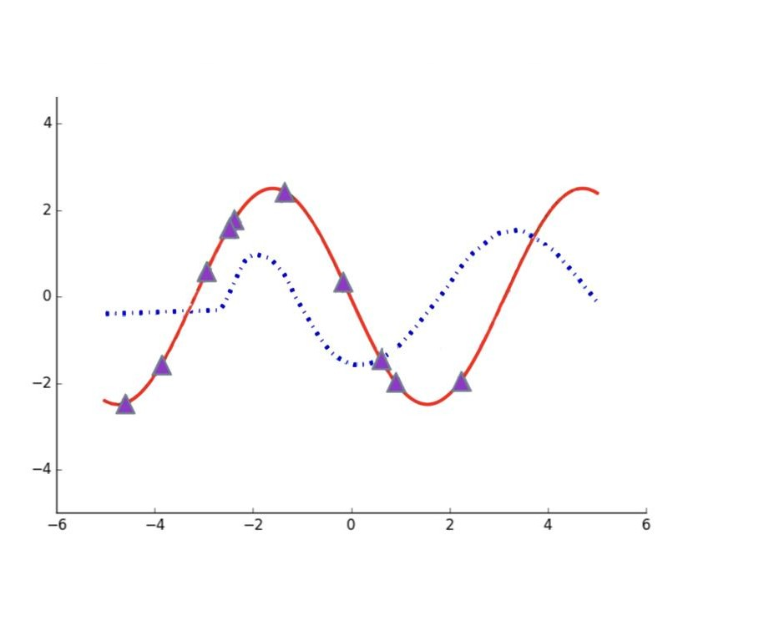
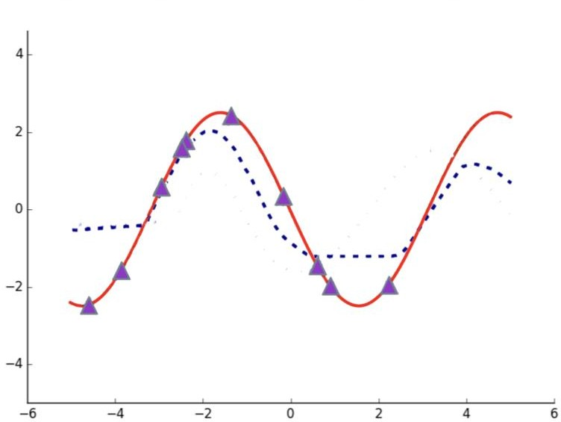
Results of 10-Shot Learning Regression
5. Experiment
[MAML] [Pretraining + Fine-tuning]
After 1 gradient step update for Adaptation to this task.

Slide 43
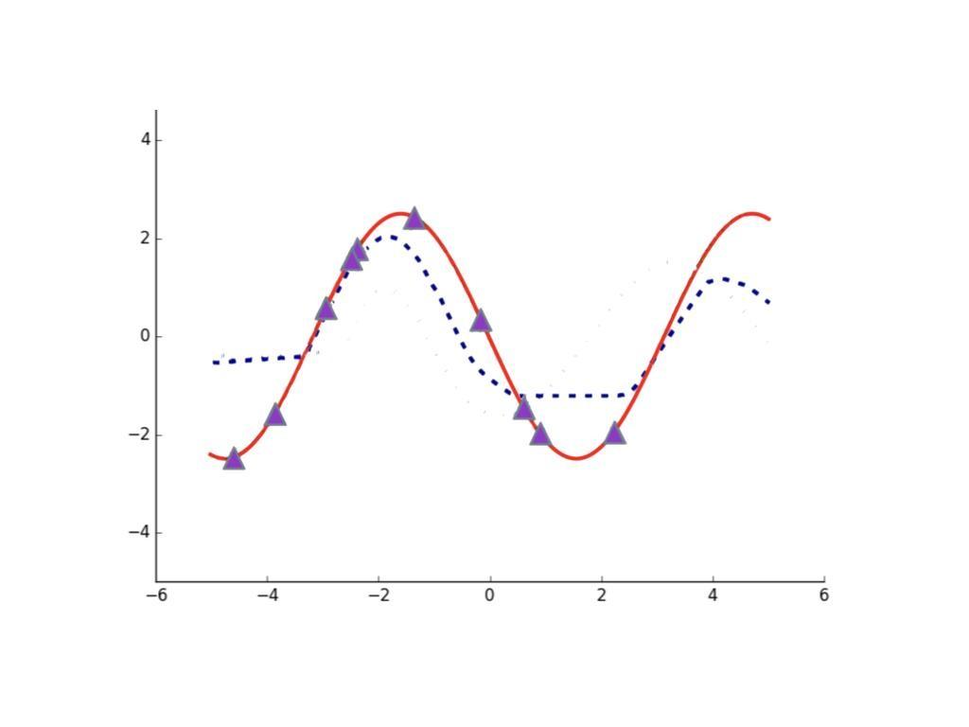
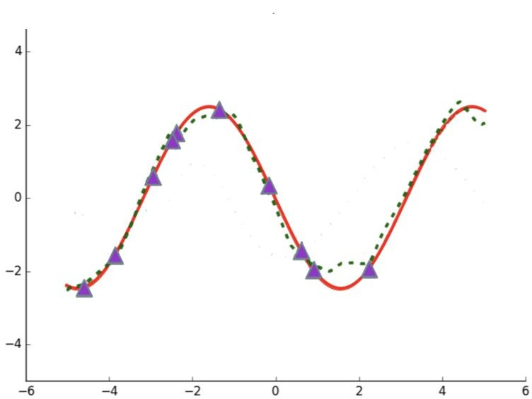
Results of 10-Shot Learning Regression
5. Experiment
[MAML] [Pretraining + Fine-tuning]
After 1 0 gradient step update for Adaptation to this task.

Slide 44
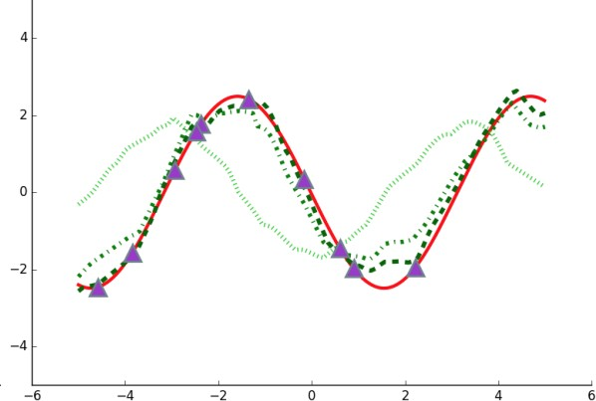
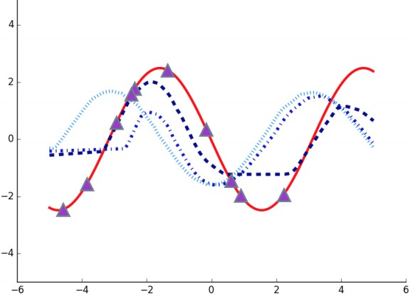
Results of 10-Shot Learning Regression
5. Experiment
[MAML] [Pretraining + Fine-tuning]
* step size 0.02
In the case of MAML, they quickly adapted to new samples.
But, adaptation failed in the case of pretraining model.

Slide 45
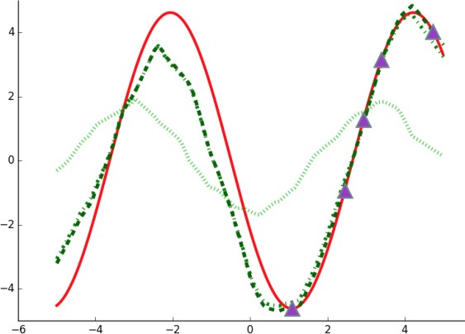
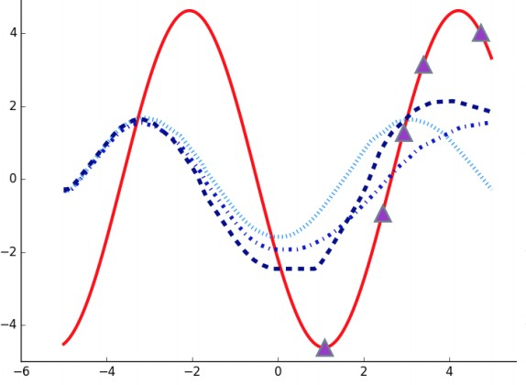
Results of 5-Shot Learning Regression
5. Experiment
[MAML] [Pretraining + Fine-tuning]
* step size 0.01
In the 5-shot learning, the difference is pervasive.

Slide 46
Results of 5-Shot Learning Regression
5. Experiment
[MAML] [Pretraining + Fine-tuning]
* step size 0.01
In the 5-shot learning, the difference is pervasive.
Good predictions are also made for ranges not particularly seen.

Slide 47
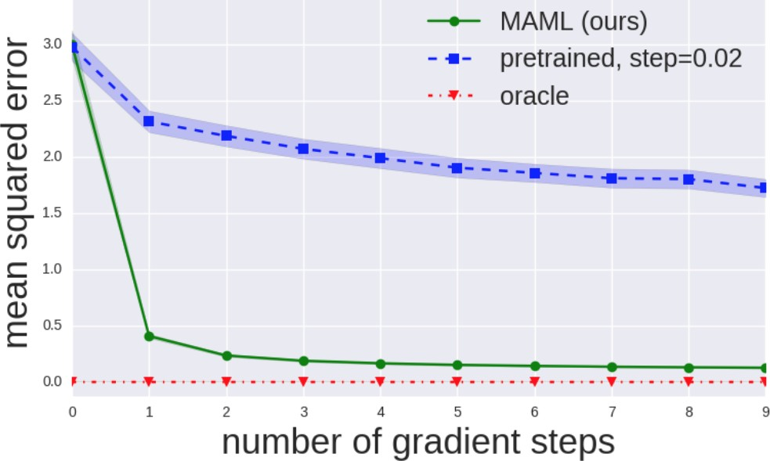
MAML Needs Only One Gradient Step
5. Experiment
Vanilla pretrained model adapted slowly,
but, the MAML method quickly adapted even in one gradient step.

Slide 48
MAML Needs Only One Gradient Step
5. Experiment
Vanilla pretrained model adapted slowly,
but, the MAML method quickly adapted even in one gradient step.
Meta parameter theta of MAML is more sensitive
than pre-updated theta of vanilla pretrained model.

Slide 49
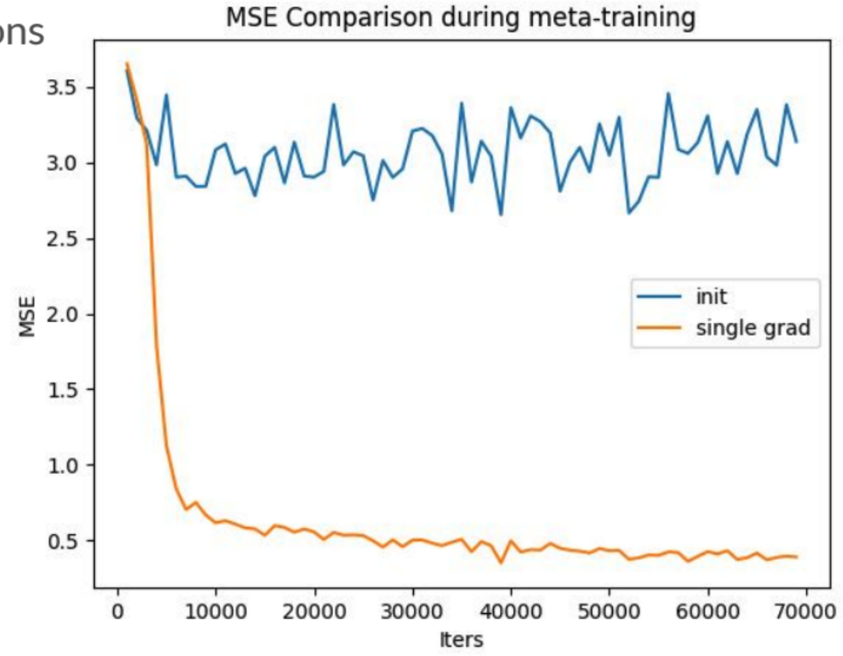
MSE of the Meta-Parameters
5. Experiment
The performance of the-meta parameters was not improved
much in training.
However, the performance of the single gradient updated parameters
started on meta-parameters improved as training progressed.

Slide 50
Experiments on Reinforcement Learning
5. Experiment
•
•
•
rllab benchmark suite
Neural network policy with two hidden layers of size 100 with ReLU Gradients updates are computed using vanilla policy gradient (REINFORCE)
and trust-region policy (TRPO) optimization as meta-optimizer.
•
Comparison
Pretraining one policy on all of the tasks and fine-tuning
Training a policy from randomly initialized weights
Oracle policy

Slide 51
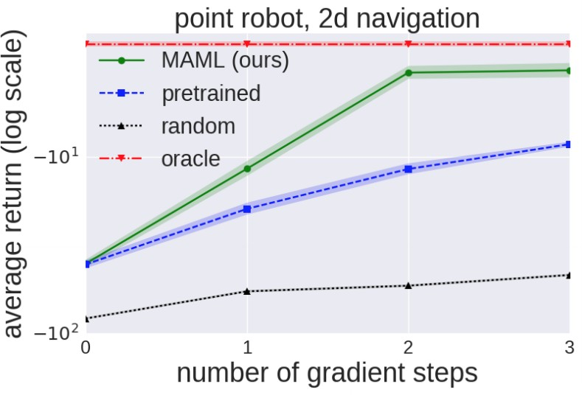
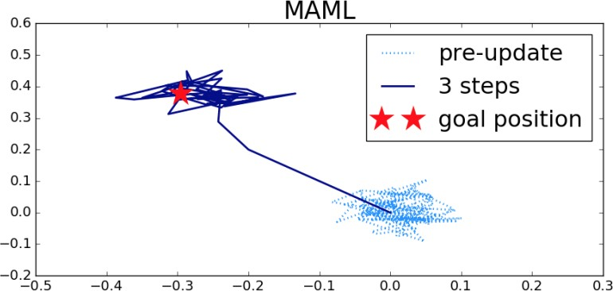
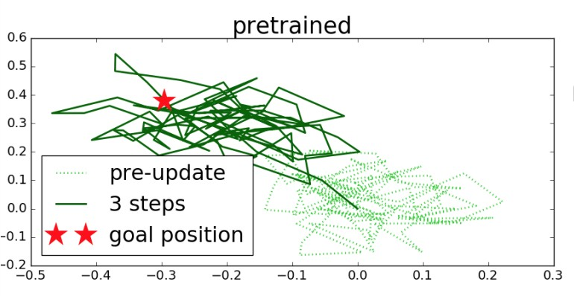
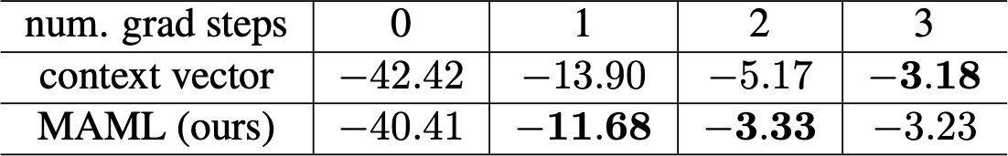
Results on Reinforcement Learning
5. Experiment
2d navigation

Slide 52
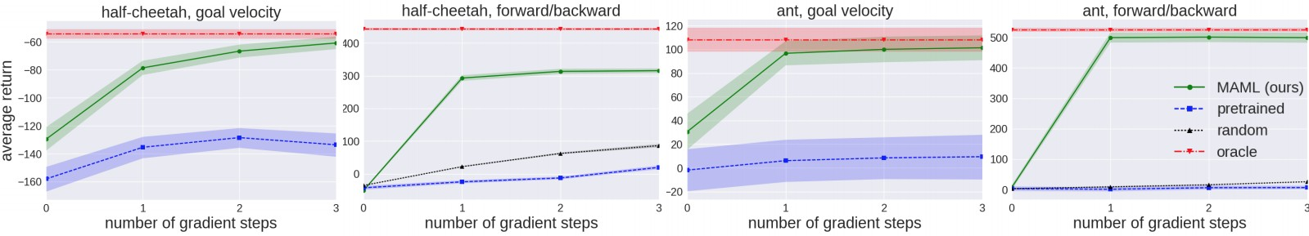
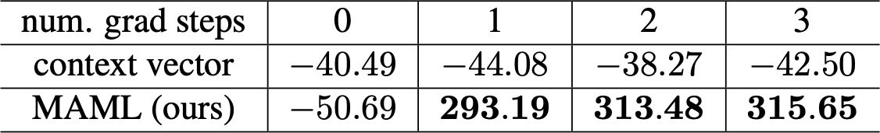
Results on Reinforcement Learning
5. Experiment
Locomotion
High-dimensional locomotion tasks with the MuJoCo simulator

Slide 53
6. Discussion
Why 1st Order Approximation Works?

Slide 54
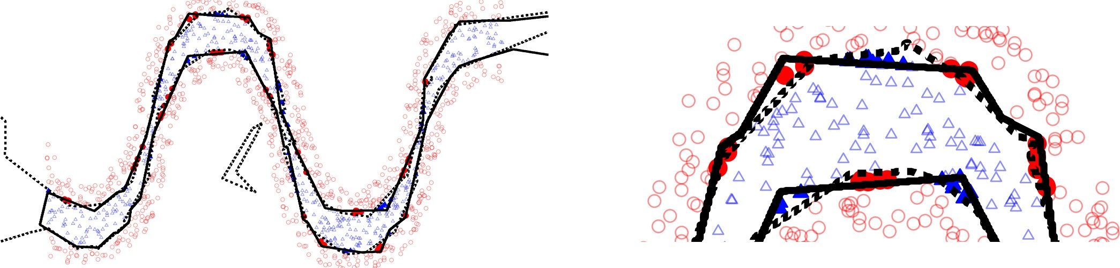
Why 1st Order Approximation Works?
6. Discussion
[Montufar14] The objective function of ReLU network is locally linear. So as the other piecewise linear activations (maxout, leaky relu, ...) are used.
Because, any composite function with linear or piecewise linear
•
•
functions should be locally linear.
Solid: Shallow network with 20 hidden units
Dotted: deep network (2 hidden layers) with 10 hidden units at each layer
magnification
•

Slide 55
Why 1st Order Approximation Works?
6. Discussion
[Montufar14] The objective function of ReLU network is locally linear. So as the other piecewise linear activations (maxout, leaky relu, ...) are used.
Because, any composite function with linear or piecewise linear
•
•
functions should be locally linear.
Solid: Shallow network with 20 hidden units
Dotted: deep network (2 hidden layers) with 10 hidden units at each layer
magnification
Hence, the Hessian matrix is almost zero.
= Hessian matrix is meaningless.

Slide 56
Why 1st Order Approximation Works?
6. Discussion
If we change the activation function from ReLU to sigmoid?

Slide 57
Why 1st Order Approximation Works?
6. Discussion
If we change the activation function from ReLU to sigmoid?
 | ReLU | sigmoid
w/o 1st order approx. | 0.1183 | 0.1579
w 1st order approx. | 0.1183 | 0.1931
[ MSE Comparison ]
 | ReLU | sigmoid
w/o 1st order approx. | 61 | 96
w 1st order approx. | 53 (13% better) | 52 (46% better)
[ Learning Time Comparison (minutes) ]

Slide 58
Why the Authors Focused on Deep Networks?
6. Discussion
•
•
•
The authors said their model (MAML) is model-agnostic. But, why they focused on deep networks?
If it is not deep networks, what kind of problem can occur?

Slide 59
Why the Authors Focused on Deep Networks?
6. Discussion
Simple linear regression model (y = θx) can be used in the MAML.
Parametrized, differentiable loss function.

Slide 60




Why the Authors Focused on Deep Networks?
6. Discussion
Simple linear regression model (y = θx) can be used in the MAML.
Parametrized, differentiable loss function.
•
Let

Slide 61
Why the Authors Focused on Deep Networks?
6. Discussion
Simple linear regression model (y = θx) can be used in the MAML.
Parametrized, differentiable loss function.
•
Let
•
Then, meta parameter θ will be 1.25.

Slide 62


6. Discussion
Why the Authors Focused on Deep Networks?
Let’s extend the setting.
The sample is drawn from | for the task | .
Then the meta parameter | .

Slide 63
6. Discussion
Why the Authors Focused on Deep Networks?
Let’s extend the setting.
The sample is drawn from | for the task | .
Then the meta parameter | .
•
•
The MAML use fixed learning rate.
More than 2 gradient steps are needed when
is far from .

Slide 64
Why the Authors Focused on Deep Networks?
6. Discussion
Let’s extend the setting.
The sample is drawn from | for the task | .
Then the meta parameter | .
•
•
The MAML use fixed learning rate.
More than 2 gradient steps are needed when is far from .
However, because the dimension of the deep model is large, there may be a meta parameter
that can quickly adapt to any task parameter .
•
That might be the reason why authors focused on deep networks.

Slide 65
Unsupervised Learning
6. Discussion
•
•
•
The authors said that the MAML is model agnostic.
They showed the MAML is worked on supervised learning.
How about unsupervised learning?

Slide 66
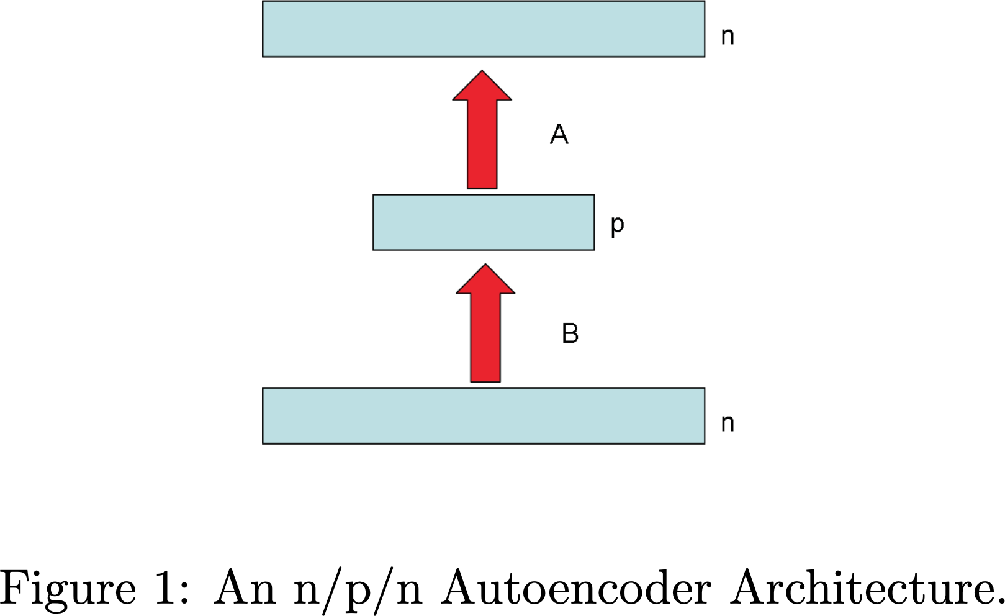
Unsupervised Learning
6. Discussion
•
•
•
The authors said that the MAML is model agnostic.
They showed the MAML is worked on supervised learning. How about unsupervised learning?
•
We can use autoencoder.
Autoencoder can make unsupervised learning
be regarded as supervised learning.
Natural Parameter Networks :
NPN takes distributions as input and goes through layers of transformation before producing distributions to match the target output distributions

Slide 67
How to Make the MAML be faster?
6. Discussion
•
•
MAML is really slow algorithm even with 1st order approximation. How can we make the MAML framework be faster?

Slide 68
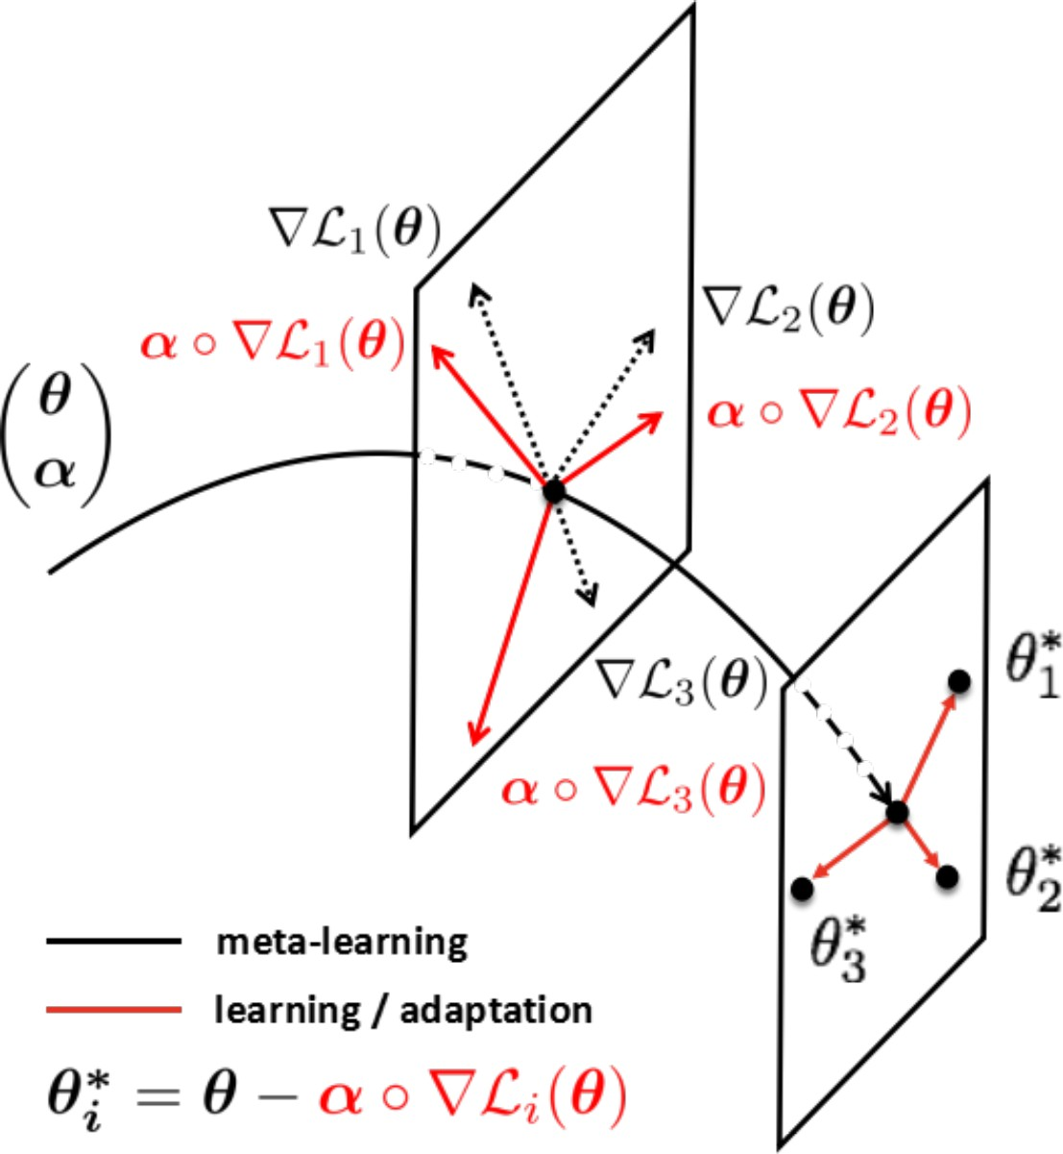
How to Make the MAML be faster?
6. Discussion
•
•
MAML is really slow algorithm even with 1st order approximation. How can we make the MAML framework be faster?
•
[Zhenguo 2017] suggests optimizing learning rate alpha.
Instead of putting alpha as a hyperparameter, train the vector alpha as the parameters
with other parameters.
It outperforms the vanilla MAML.
•
•

Slide 69
Thank you!

Slide 70
Reference
Finn, Chelsea, Pieter Abbeel, and Sergey Levine. "Model-agnostic meta-learning for fast adaptation of deep networks." arXiv preprint
arXiv:1703.03400 (2017).
Montufar, Guido F., et al. "On the number of linear regions of deep neural networks." Advances in neural information processing systems. 2014.
Baldi, Pierre. "Autoencoders, unsupervised learning, and deep architectures." Proceedings of ICML workshop on unsupervised and transfer learning. 2012.
Li, Zhenguo, et al. "Meta-sgd: Learning to learn quickly for few shot learning." arXiv preprint arXiv:1707.09835 (2017)
•
•
•

Slide 71
Reference
https://www.slideshare.net/TaesuKim3/pr12094-modelagnostic- metalearning-for-fast-adaptation-of-deep-networks
https://people.eecs.berkeley.edu/~cbfinn/_files/ nips2017_metaworkshop.pdf
https://github.com/cbfinn/maml

